Slide 1
WhatsApp Messenger
Name: Sambhram Jain
Somaiya Vidyavihar University
2022-2023

Slide 2

Introduction:
WhatsApp Messenger, or simply WhatsApp, is an internationally available American freeware and voice-over-IP (VoIP) service owned by Meta Platforms.
It allows users to send text messages and voice messages,^{[13]} make voice and video calls, and share images, documents, user locations, and other content.
WhatsApp's client application runs on mobile devices but is also accessible from desktop computers.
The service requires a cellular mobile telephone number to sign up.
The client application was created by WhatsApp Inc. of Mountain View, California, which was acquired by Facebook in February 2014 for approximately US$19.3 billion.

Slide 3
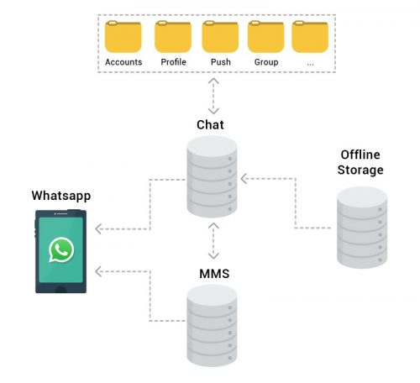
How Whatsapp messaging app works?
WhatsApp uses Ejabberd (XMPP) server.
ERLANG is the programming language used to code WhatsApp.
Data transfer in Whatsapp.
Mnesia DB and FreeBSD.

Slide 4
What information does WhatsApp collect?
Information
You
Provide
Automatically Collected Information
Third-Party Information

Slide 5
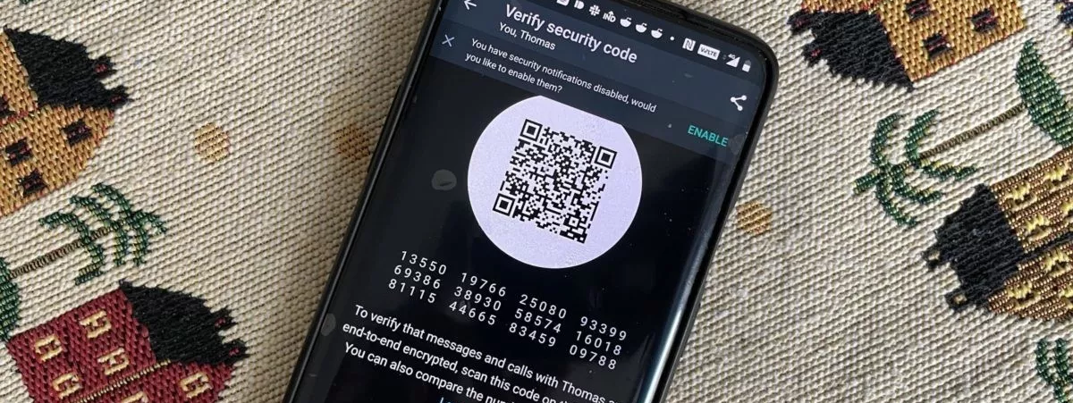
What data won’t be collected by WhatsApp?

Slide 6
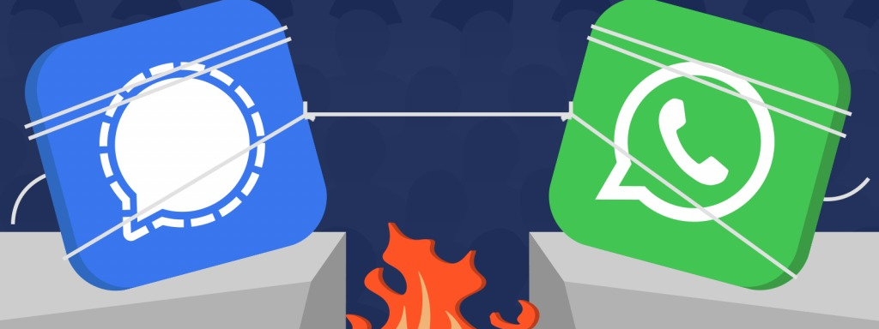
WhatsApp vs Signal

Slide 7
THANK YOU
DO YOU HAVE ANY QUESTIONS?

